Slide 1



EXERCISE

Slide 2
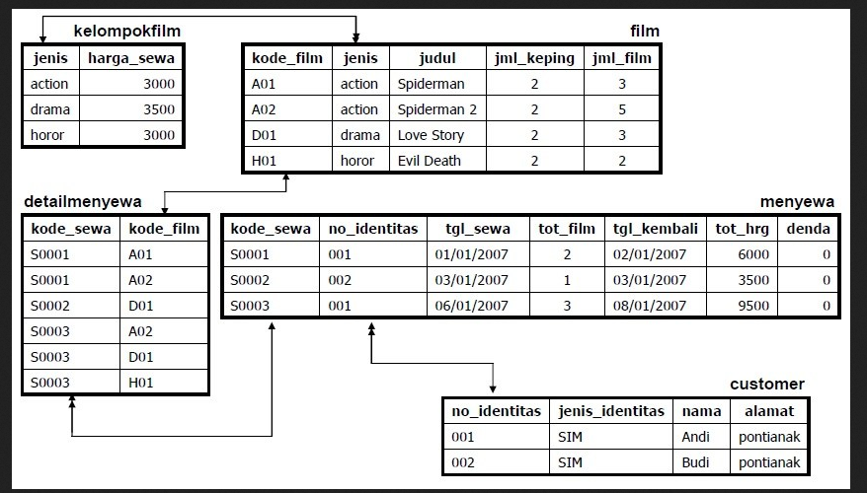
EXERCISE
Do the exercise using PostgreSQL
Use DDL syntax of previous exercise to create tables below:
Note:
kelompokfilm.jenis, film.kode_film, customer.no_identitas, menyewa.kode_sewa = primary key
film.jenis, detailmenyewa.kode_sewa, detailmenyewa.kode_film, menyewa.no_identitas = foreign key
Add a new column id_detailmenyewa in detailmenyewa table as primary key
www.its.ac.id
INSTITUT TEKNOLOGI SEPULUH NOPEMBER, Surabaya - Indonesia

Slide 3
EXERCISE
Add new genre: “Komedi” with harga_sewa 5000 in kelompokfilm table
Add new data as below in film table:
Update the data on the harga_sewa of kelompokfilm table by multiplying 10 on the harga_sewa. Example the harga_sewa of genre Action is changed to 30000 because 3000x10 = 30000
Select kode_film and judul from film table that have horror or drama genre
K01 | Komedi | Kapan Kawin | 10 | 2
K02 | Komedi | Takut Kawin | 6 | 3
D02 | Drama | Ayat ayat Cinta | 8 | 3
D03 | Drama | Tiga doa tiga Cinta | 5 | 2
H02 | Horror | Resident Evil | 7 | 4
www.its.ac.id
INSTITUT TEKNOLOGI SEPULUH NOPEMBER, Surabaya - Indonesia

Slide 4
EXERCISE
Select the data number of detailmenyewa table that have kode_sewa S0003!
Select no_identitas, tanggal_sewa, tot_film of menyewa table that have a minimum number of tot_film!
Select names and addresses of customers who returned films before 5 Jan 2007!
Select no_identitas and judul that has the initial letter of judul is S!
Select the name of the customer who rented the movie genre “drama”!
www.its.ac.id
INSTITUT TEKNOLOGI SEPULUH NOPEMBER, Surabaya - Indonesia

Slide 5

Gambar bisa diganti*
- TERIMA KASIH -

